Slide 1

Batik Industry in Sri Lanka

Slide 2
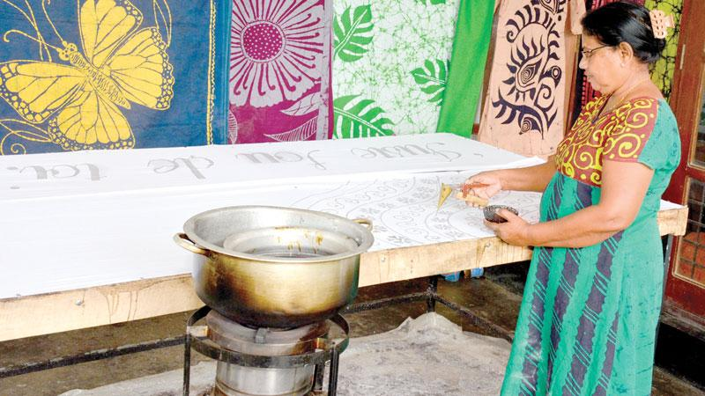
Overview
Introduction
Literature Review
Methodology
References

Slide 3
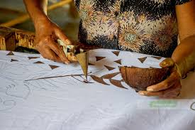
Introduction
Batik is a Javanese word. It is an art and methodology for creating design. It is usually done on cloth by applying wax on materials. This was introduced by the Dutch. Batik industry in Sri Lanka has to face a lot of challenges and lack of raw materials is one of the problems. Accordingly, studying the background of the Batik Industry, identifying the research problems, can be mentioned as key objectives of the study. Next, the literature review and the methodology will be presented.

Slide 4
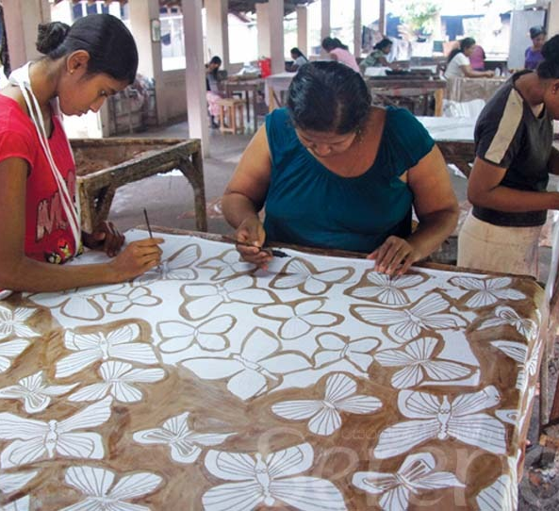
Literature Review
Web site –Potential of upgrading Sri Lanka Batik Industry Ruwanpathirana, US (UOM)
Web site – “Sri Lanka Batik Industry – heading for vibrant future by Sri Lanka export development Board (2015.08.21)
Wikipedia – Batik Industry in Sri Lanka

Slide 5
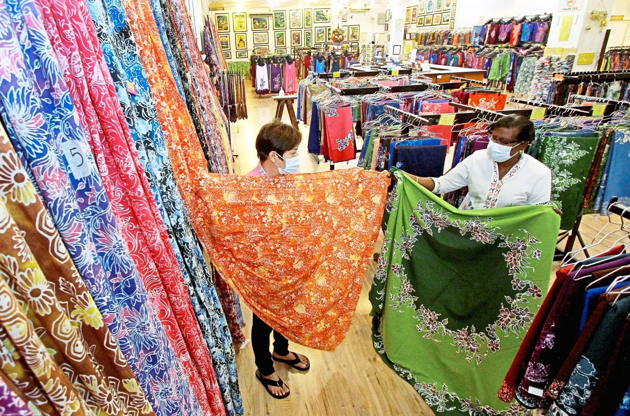
Methodology
Interviews - Batik Manufactures
Observation

Slide 6

References
Ruwanpathirana (retrieved on 25th September) “Potential of upgrading Sri Lanka Batik Industry”, Digital Library of University of Moratuwa.
2015.08.21 “Sri Lanka Batik Industry - Heading for a Vibrant Future”, Sri Lanka Export Development Board

Slide 7
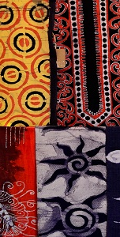
THANK YOU

